Slide 1


Dotnet for Infrastructure Automation
Adora Nwodo

Slide 2
AUTOMATION
@adoranwodo

Slide 3
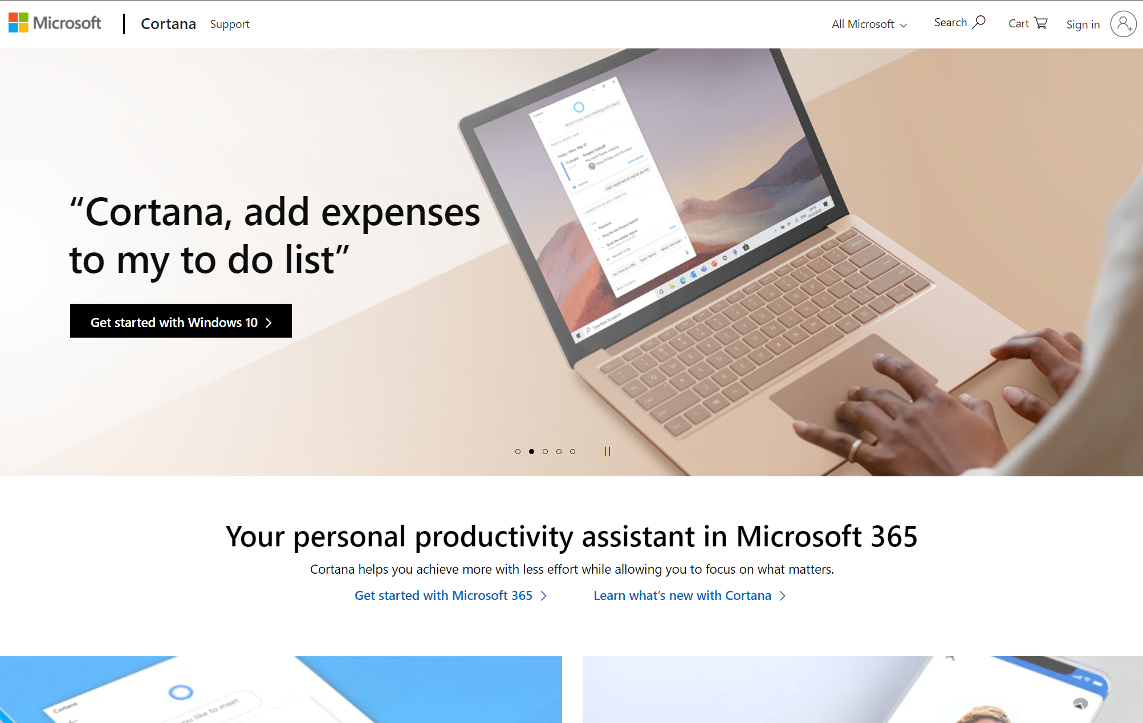
@adoranwodo

Slide 4
We use code to automate mundane tasks in our lives
@adoranwodo

Slide 5

@adoranwodo

Slide 6
@adoranwodo

Slide 7

@adoranwodo

Slide 8
We use code to automate mundane tasks in our lives
@adoranwodo

Slide 9
Now let’s use code to automate the coding process
@adoranwodo

Slide 10
How can we write code to automate our Infrastructure deployments ?
@adoranwodo

Slide 11

Hi, I’m Adora Software Engineer, Microsoft Mixed Reality Tech Content Creator, AdoraHack CoFounder, unStack Advisory Board, VRARA Nigeria @adoranwodo

Slide 12
Manual Configurations
@adoranwodo
- Deployments are slower - Larger risks of errors - Everyone relies on documentation - Rollbacks require manual work

Slide 13
@adoranwodo

Slide 14
CONFIGURATION DRIFT
@adoranwodo

Slide 15
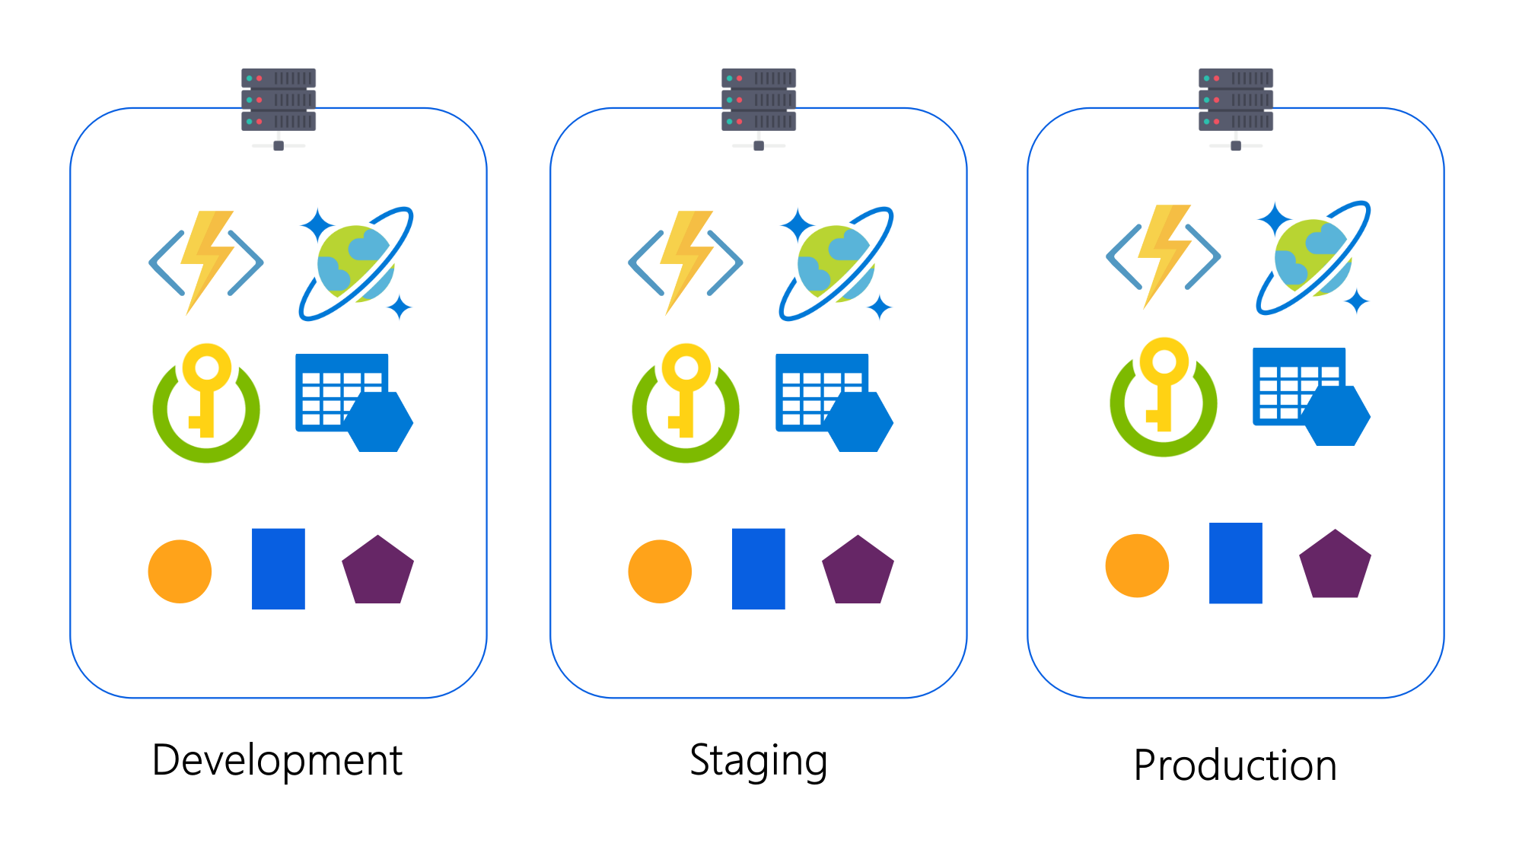
@adoranwodo

Slide 16
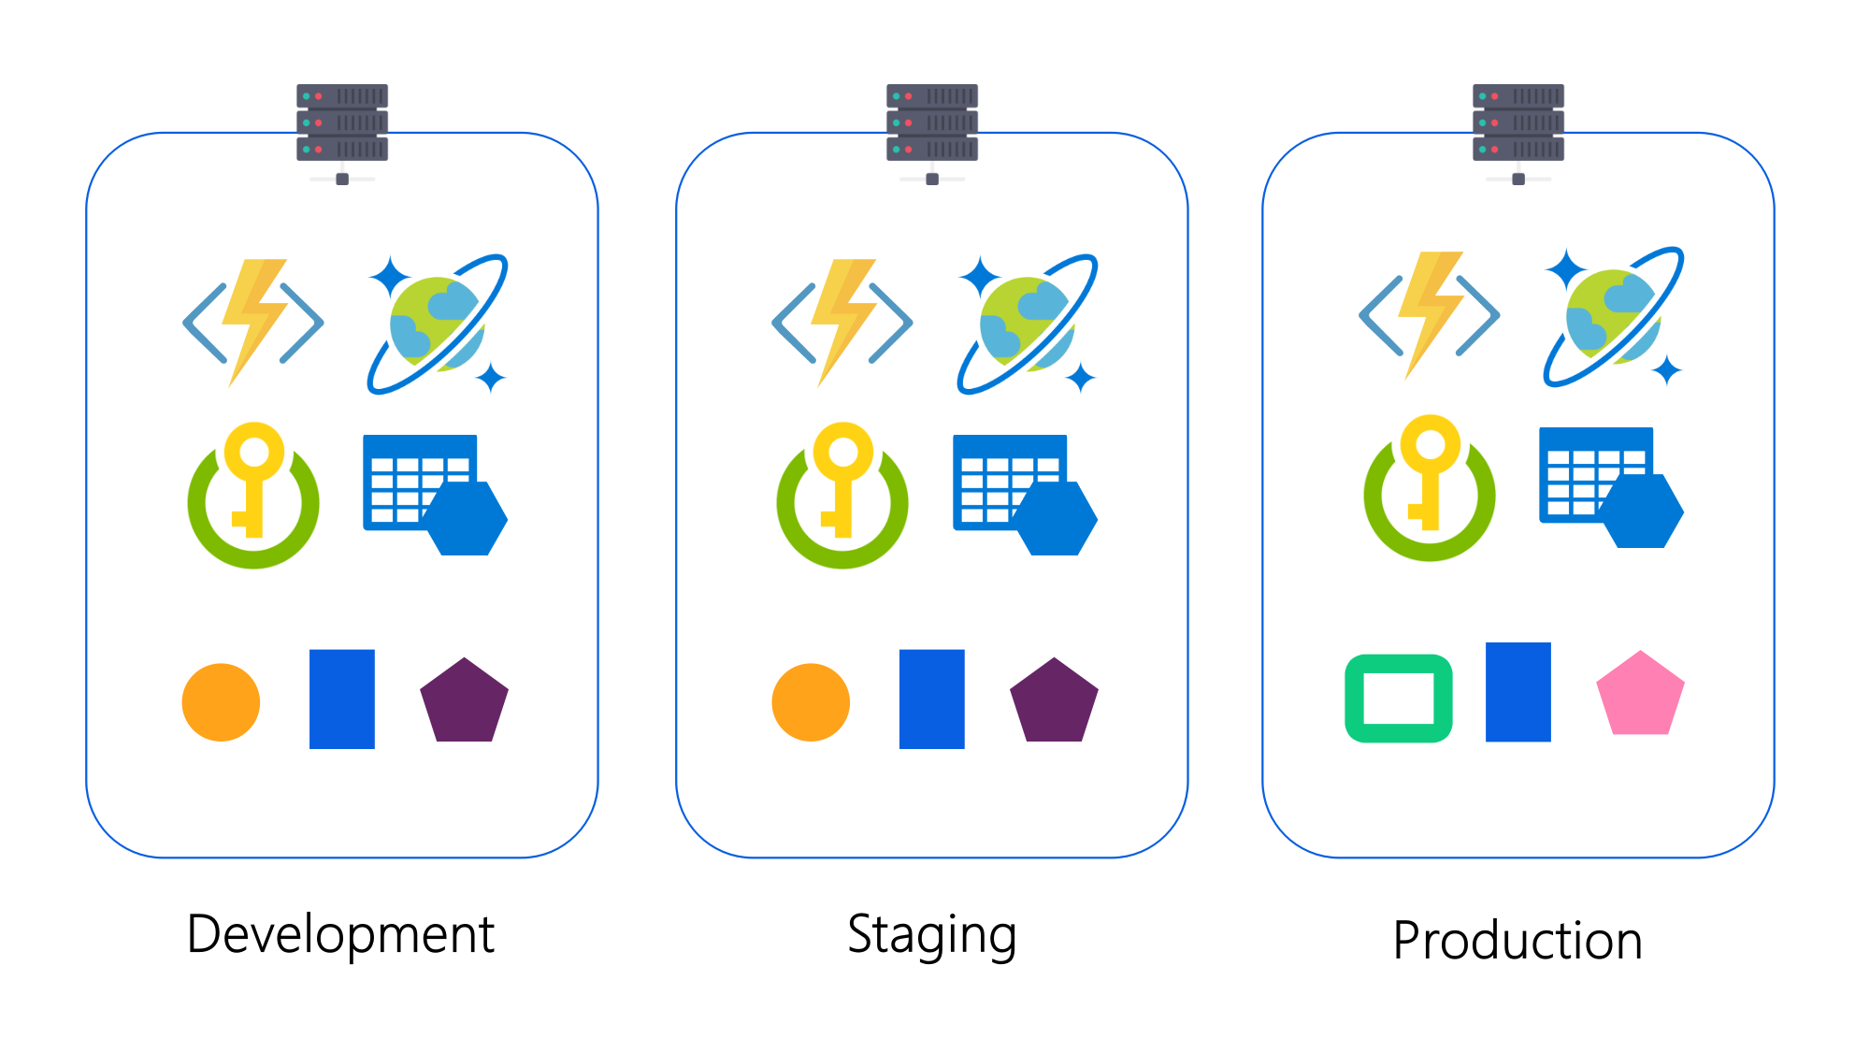
@adoranwodo

Slide 17
Infrastructure as Code
@adoranwodo
- Configurations are specified in code - You can test, version and rollback
your infrastructure.
- Automate infrastructure deployments

Slide 18
Why Dotnet?
@adoranwodo
Familiarity
Reuse
Expressiveness
Productivity

Slide 19
@adoranwodo
var storageAccount = new Account("storage", new AccountArgs {
ResourceGroupName = resourceGroup.Name,
AccountReplicationType = "LRS",
AccountTier = "Standard"
});

Slide 20
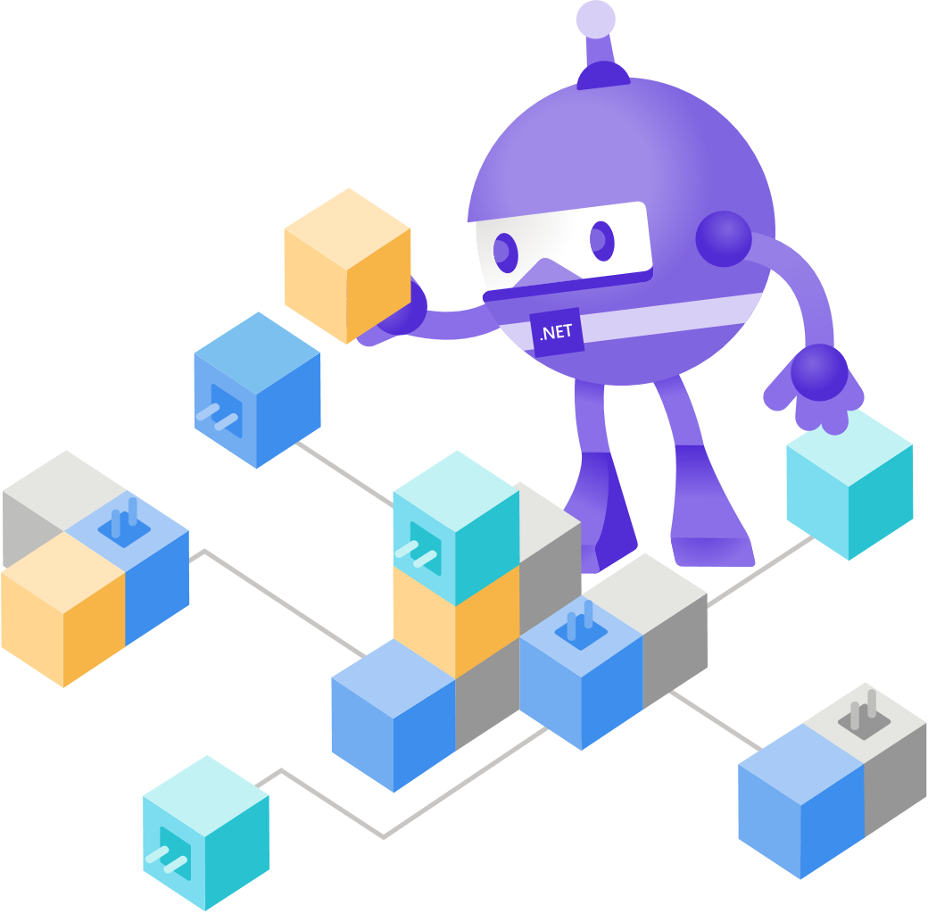
Case Study: Dotnet for Infrastructure Automation
@adoranwodo

Slide 21

This is Oge. She needs to create infrastructure for an Azure Functions app and deploy this to two environments. Here is a list of the resources she needs: - App Service Plan - Storage Account - Function App
@adoranwodo

Slide 22
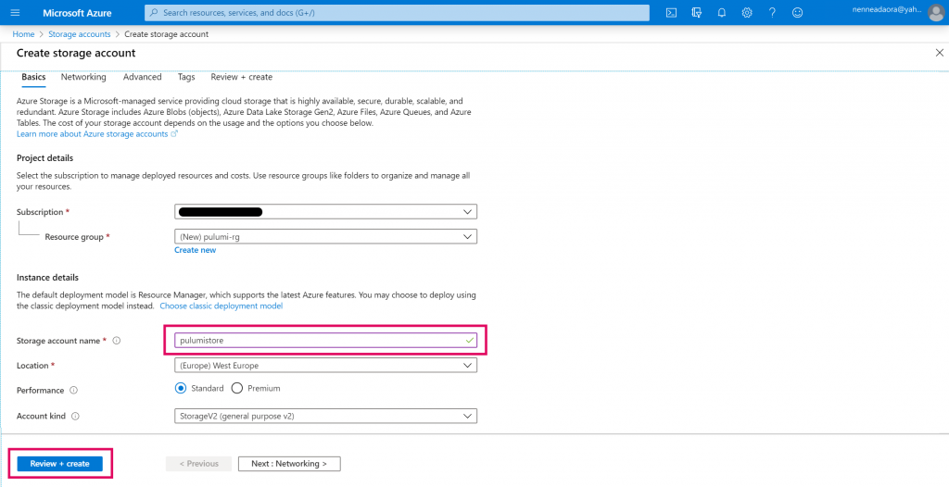
@adoranwodo

Slide 23
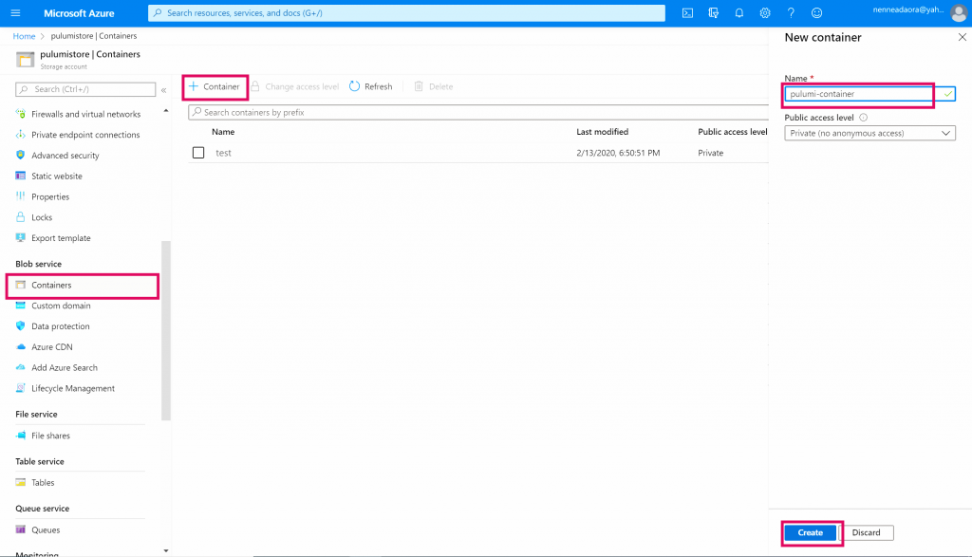
@adoranwodo

Slide 24
Powershell
@adoranwodo
# Login to Azure CLI
az login
# Set the required environment variables
$env:AZURE_STORAGE_ACCOUNT = "pulumistore"
$env:AZURE_STORAGE_KEY = "<storage-account-key>"
# Install pulumi
choco install pulumi
# Create iac working directory
mkdir iac && cd iac
# Login to Pulumi
pulumi login --cloud-url azblob://pulumi-container
# Create pulumi project in ./iac
pulumi new azure-csharp

Slide 25
Powershell
@adoranwodo
# Login to Azure CLI
az login
# Set the required environment variables
$env:AZURE_STORAGE_ACCOUNT = "pulumistore"
$env:AZURE_STORAGE_KEY = "<storage-account-key>"
# Install pulumi
choco install pulumi
# Create iac working directory
mkdir iac && cd iac
# Login to Pulumi
pulumi login --cloud-url azblob://pulumi-container
# Create pulumi project in ./iac
pulumi new azure-csharp

Slide 26
Powershell
@adoranwodo
# Login to Azure CLI
az login
# Set the required environment variables
$env:AZURE_STORAGE_ACCOUNT = "pulumistore"
$env:AZURE_STORAGE_KEY = "<storage-account-key>"
# Install pulumi
choco install pulumi
# Create iac working directory
mkdir iac && cd iac
# Login to Pulumi
pulumi login --cloud-url azblob://pulumi-container
# Create pulumi project in ./iac
pulumi new azure-csharp

Slide 27
Powershell
@adoranwodo
# Login to Azure CLI
az login
# Set the required environment variables
$env:AZURE_STORAGE_ACCOUNT = "pulumistore"
$env:AZURE_STORAGE_KEY = "<storage-account-key>"
# Install pulumi
choco install pulumi
# Create iac working directory
mkdir iac && cd iac
# Login to Pulumi
pulumi login --cloud-url azblob://pulumi-container
# Create pulumi project in ./iac
pulumi new azure-csharp

Slide 28
Powershell
@adoranwodo
# Login to Azure CLI
az login
# Set the required environment variables
$env:AZURE_STORAGE_ACCOUNT = "pulumistore"
$env:AZURE_STORAGE_KEY = "<storage-account-key>"
# Install pulumi
choco install pulumi
# Create iac working directory
mkdir iac && cd iac
# Login to Pulumi
pulumi login --cloud-url azblob://pulumi-container
# Create pulumi project in ./iac
pulumi new azure-csharp

Slide 29
Powershell
@adoranwodo
# Login to Azure CLI
az login
# Set the required environment variables
$env:AZURE_STORAGE_ACCOUNT = "pulumistore"
$env:AZURE_STORAGE_KEY = "<storage-account-key>"
# Install pulumi
choco install pulumi
# Create iac working directory
mkdir iac && cd iac
# Login to Pulumi
pulumi login --cloud-url azblob://pulumi-container
# Create pulumi project in ./iac
pulumi new azure-csharp

Slide 30
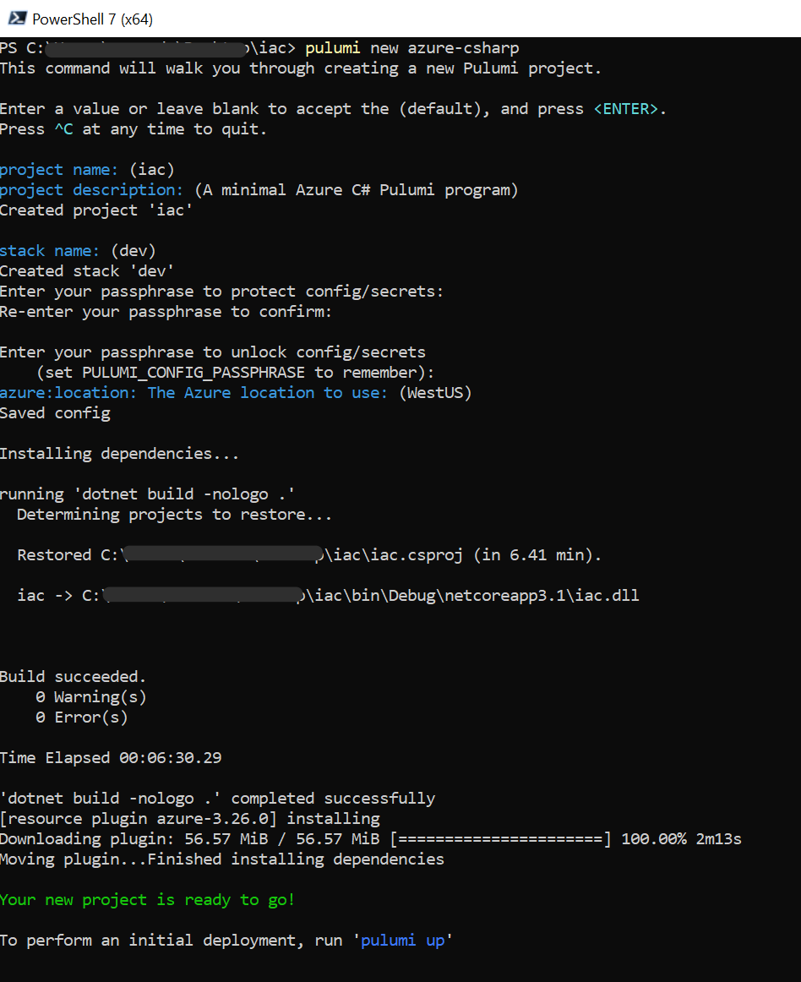
Powershell
@adoranwodo
# Login to Azure CLI
az login
# Set the required environment variables
$env:AZURE_STORAGE_ACCOUNT = "pulumistore"
$env:AZURE_STORAGE_KEY = "<storage-account-key>"
# Install pulumi
choco install pulumi
# Create iac working directory
mkdir iac && cd iac
# Login to Pulumi
pulumi login --cloud-url azblob://pulumi-container
# Create pulumi project in ./iac
pulumi new azure-csharp

Slide 31
Pulumi.dev.yaml
@adoranwodo
encryptionsalt: ENCRYPTION_SALT
config:
iac:appServicePlanSize: S1
iac:appServicePlanTier: Standard
iac:env: dev
iac:location: WestEurope
Pulumi.prod.yaml
encryptionsalt: ENCRYPTION_SALT
config:
iac:appServicePlanSize: P1v2
iac:appServicePlanTier: Premium V2
iac:env: prod
iac:location: WestUS2

Slide 32
Program.cs
@adoranwodo
class Program
{
static Task<int> Main() => Deployment.RunAsync<MyStack>();
}
// where MyStack: Stack

Slide 33
MyStack.cs
@adoranwodo
using Pulumi;
using Pulumi.Azure.AppService;
using Pulumi.Azure.AppService.Inputs;
using Pulumi.Azure.Core;
using Pulumi.Azure.Storage;
class MyFunctionApp : Stack
{
private const string AppServicePlanBaseName = "sample-pulumi-plan";
private const string FunctionAppBaseName = "sample-pulumi-app";
private const string ResourceGroupBaseName = "sample-pulumi-rg";
private const string StorageAccountBaseName = "samplepulumistore";
public MyStack() { … }
private InputMap<string> GetAppSettingsMap(Config config) { … }
[Output]
public Output<string> FunctionAppUrl { get; set; }
}

Slide 34
MyStack.cs
@adoranwodo
using Pulumi;
using Pulumi.Azure.AppService;
using Pulumi.Azure.AppService.Inputs;
using Pulumi.Azure.Core;
using Pulumi.Azure.Storage;
class MyFunctionApp : Stack
{
private const string AppServicePlanBaseName = "sample-pulumi-plan";
private const string FunctionAppBaseName = "sample-pulumi-app";
private const string ResourceGroupBaseName = "sample-pulumi-rg";
private const string StorageAccountBaseName = "samplepulumistore";
public MyFunctionApp() { … }
private InputMap<string> GetAppSettingsMap(Config config) { … }
[Output]
public Output<string> FunctionAppUrl { get; set; }
}

Slide 35
MyStack.cs
@adoranwodo
using Pulumi;
using Pulumi.Azure.AppService;
using Pulumi.Azure.AppService.Inputs;
using Pulumi.Azure.Core;
using Pulumi.Azure.Storage;
class MyFunctionApp : Stack
{
private const string AppServicePlanBaseName = "sample-pulumi-plan";
private const string FunctionAppBaseName = "sample-pulumi-app";
private const string ResourceGroupBaseName = "sample-pulumi-rg";
private const string StorageAccountBaseName = "samplepulumistore";
public MyFunctionApp() { … }
private InputMap<string> GetAppSettingsMap(Config config) { … }
[Output]
public Output<string> FunctionAppUrl { get; set; }
}

Slide 36
MyStack.cs
@adoranwodo
using Pulumi;
using Pulumi.Azure.AppService;
using Pulumi.Azure.AppService.Inputs;
using Pulumi.Azure.Core;
using Pulumi.Azure.Storage;
class MyFunctionApp : Stack
{
private const string AppServicePlanBaseName = "sample-pulumi-plan";
private const string FunctionAppBaseName = "sample-pulumi-app";
private const string ResourceGroupBaseName = "sample-pulumi-rg";
private const string StorageAccountBaseName = "samplepulumistore";
public MyFunctionApp() { … }
private InputMap<string> GetAppSettingsMap(Config config) { … }
[Output]
public Output<string> FunctionAppUrl { get; set; }
}

Slide 37
MyStack.cs
@adoranwodo
using Pulumi;
using Pulumi.Azure.AppService;
using Pulumi.Azure.AppService.Inputs;
using Pulumi.Azure.Core;
using Pulumi.Azure.Storage;
class MyFunctionApp : Stack
{
private const string AppServicePlanBaseName = "sample-pulumi-plan";
private const string FunctionAppBaseName = "sample-pulumi-app";
private const string ResourceGroupBaseName = "sample-pulumi-rg";
private const string StorageAccountBaseName = "samplepulumistore";
public MyFunctionApp() { … }
private InputMap<string> GetAppSettingsMap(Config config) { … }
[Output]
public Output<string> FunctionAppUrl { get; set; }
}

Slide 38
MyStack.cs
@adoranwodo
using Pulumi;
using Pulumi.Azure.AppService;
using Pulumi.Azure.AppService.Inputs;
using Pulumi.Azure.Core;
using Pulumi.Azure.Storage;
class MyFunctionApp : Stack
{
// ...
// Code omitted
public MyFunctionApp() { … }
private InputMap<string> GetAppSettingsMap(Config config) {
var appSettings = new InputMap<string>();
appSettings.Add("CLOUD_SERVICE_CONFIG", config.Require("env"));
return appSettings;
}
[Output]
public Output<string> FunctionAppUrl { get; set; }
}

Slide 39
MyStack.cs
@adoranwodo
class MyFunctionApp : Stack
{
// ...
// Code omitted
public MyFunctionApp() {
// Get Pulumi Configs
var config = new Config();
var appServicePlanSize = config.Require("appServicePlanSize");
var appServicePlanTier = config.Require("appServicePlanTier");
var env = config.Require("env");
var location = config.Require(“location");
}
private InputMap<string> GetAppSettingsMap(Config config) { … }
[Output]
public Output<string> FunctionAppUrl { get; set; }
}

Slide 40
MyStack.cs
@adoranwodo
class MyFunctionApp : Stack
{
// ...
// Code omitted
public MyFunctionApp() {
// Get Pulumi Configs …
// Create an Azure Resource Group
var resourceGroup = new ResourceGroup($"{ResourceGroupBaseName}-{env}", new ResourceGroupArgs {
Location = location,
Name = $"{ResourceGroupBaseName}-{env}",
});
}
private InputMap<string> GetAppSettingsMap(Config config) { … }
[Output]
public Output<string> FunctionAppUrl { get; set; }
}

Slide 41
MyStack.cs
@adoranwodo
class MyFunctionApp : Stack
{
// ...
// Code omitted
public MyFunctionApp() {
// Get Pulumi Configs …
// Create an Azure Resource Group
var resourceGroup = new ResourceGroup();
// Create an Azure Storage account
var storageAccount = new Account($"{StorageAccountBaseName}{env}", new AccountArgs
{
ResourceGroupName = resourceGroup.Name,
Name = $"{StorageAccountBaseName}{env}“,
AccountReplicationType = "LRS",
AccountTier = "Standard"
});
}
private InputMap<string> GetAppSettingsMap(Config config) { … }
[Output]
public Output<string> FunctionAppUrl { get; set; }
}

Slide 42
MyStack.cs
@adoranwodo
class MyFunctionApp : Stack
{
// ...
// Code omitted
public MyFunctionApp() {
// Get Pulumi Configs …
// Create an Azure Resource Group
var resourceGroup = new ResourceGroup();
// Create an Azure Storage account
var storageAccount = new Account();
// Create an App Service Plan
var appServicePlan = new Plan($"{AppServicePlanBaseName}-{env}", new PlanArgs
{
Location = resourceGroup.Location,
MaximumElasticWorkerCount = 1,
Name = $"{AppServicePlanBaseName}-{env}",
ResourceGroupName = resourceGroup.Name,
Sku = new PlanSkuArgs
{
Size = appServicePlanSize,
Tier = appServicePlanTier
}
});
}
}

Slide 43
MyStack.cs
@adoranwodo
class MyFunctionApp : Stack
{
// ...
// Code omitted
public MyFunctionApp() {
// Get Pulumi Configs …
// Create an Azure Resource Group
var resourceGroup = new ResourceGroup();
// Create an Azure Storage account
var storageAccount = new Account();
// Create an App Service Plan
var appServicePlan = new Plan();
// Create a Function App
var functionApp = new FunctionApp($"{FunctionAppBaseName}-{env}", new FunctionAppArgs {
Name = $"{FunctionAppBaseName}-{env}",
StorageAccountName = storageAccount.Name,
AppServicePlanId = appServicePlan.Id,
Location = resourceGroup.Location,
ResourceGroupName = resourceGroup.Name,
StorageAccountAccessKey = storageAccount.PrimaryAccessKey,
Identity = new FunctionAppIdentityArgs { Type = "SystemAssigned“ },
Version = "~3",
AppSettings = GetAppSettingsMap(config),
SiteConfig = new FunctionAppSiteConfigArgs { AlwaysOn = true, Use32BitWorkerProcess = false, WebsocketsEnabled = false }
});
}
}

Slide 44
MyStack.cs
@adoranwodo
class MyFunctionApp : Stack
{
// ...
// Code omitted
public MyFunctionApp() {
// Get Pulumi Configs …
// Create an Azure Resource Group
var resourceGroup = new ResourceGroup();
// Create an Azure Storage account
var storageAccount = new Account();
// Create an App Service Plan
var appServicePlan = new Plan();
// Create a Function App
var functionApp = new FunctionApp();
// Export the Function App Url
this.FunctionAppUrl = functionApp.DefaultHostname.Apply(hostName => $"https://{hostName}");
}
private InputMap<string> GetAppSettingsMap(Config config) { … }
[Output]
public Output<string> FunctionAppUrl { get; set; }
}

Slide 45
Program.cs
@adoranwodo
class Program
{
static Task<int> Main() => Deployment.RunAsync<MyFunctionApp>();
}

Slide 46
Program.cs
@adoranwodo
class Program
{
static Task<int> Main() => Deployment.RunAsync<MyFunctionApp>();
}
class Program
{
static Task<int> Main()
{
return Deployment.RunAsync(()=>
{
var app = new MyFunctionApp();
// Now you can do something with app.FunctionAppUrl;
});
}
}

Slide 47
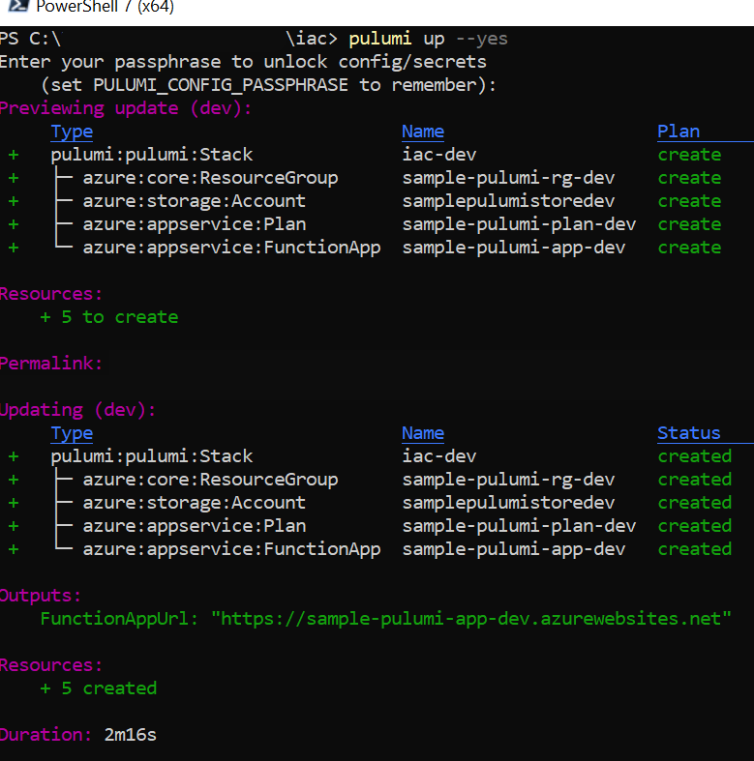
Powershell
@adoranwodo
# Deploy infrastructure
pulumi up

Slide 48
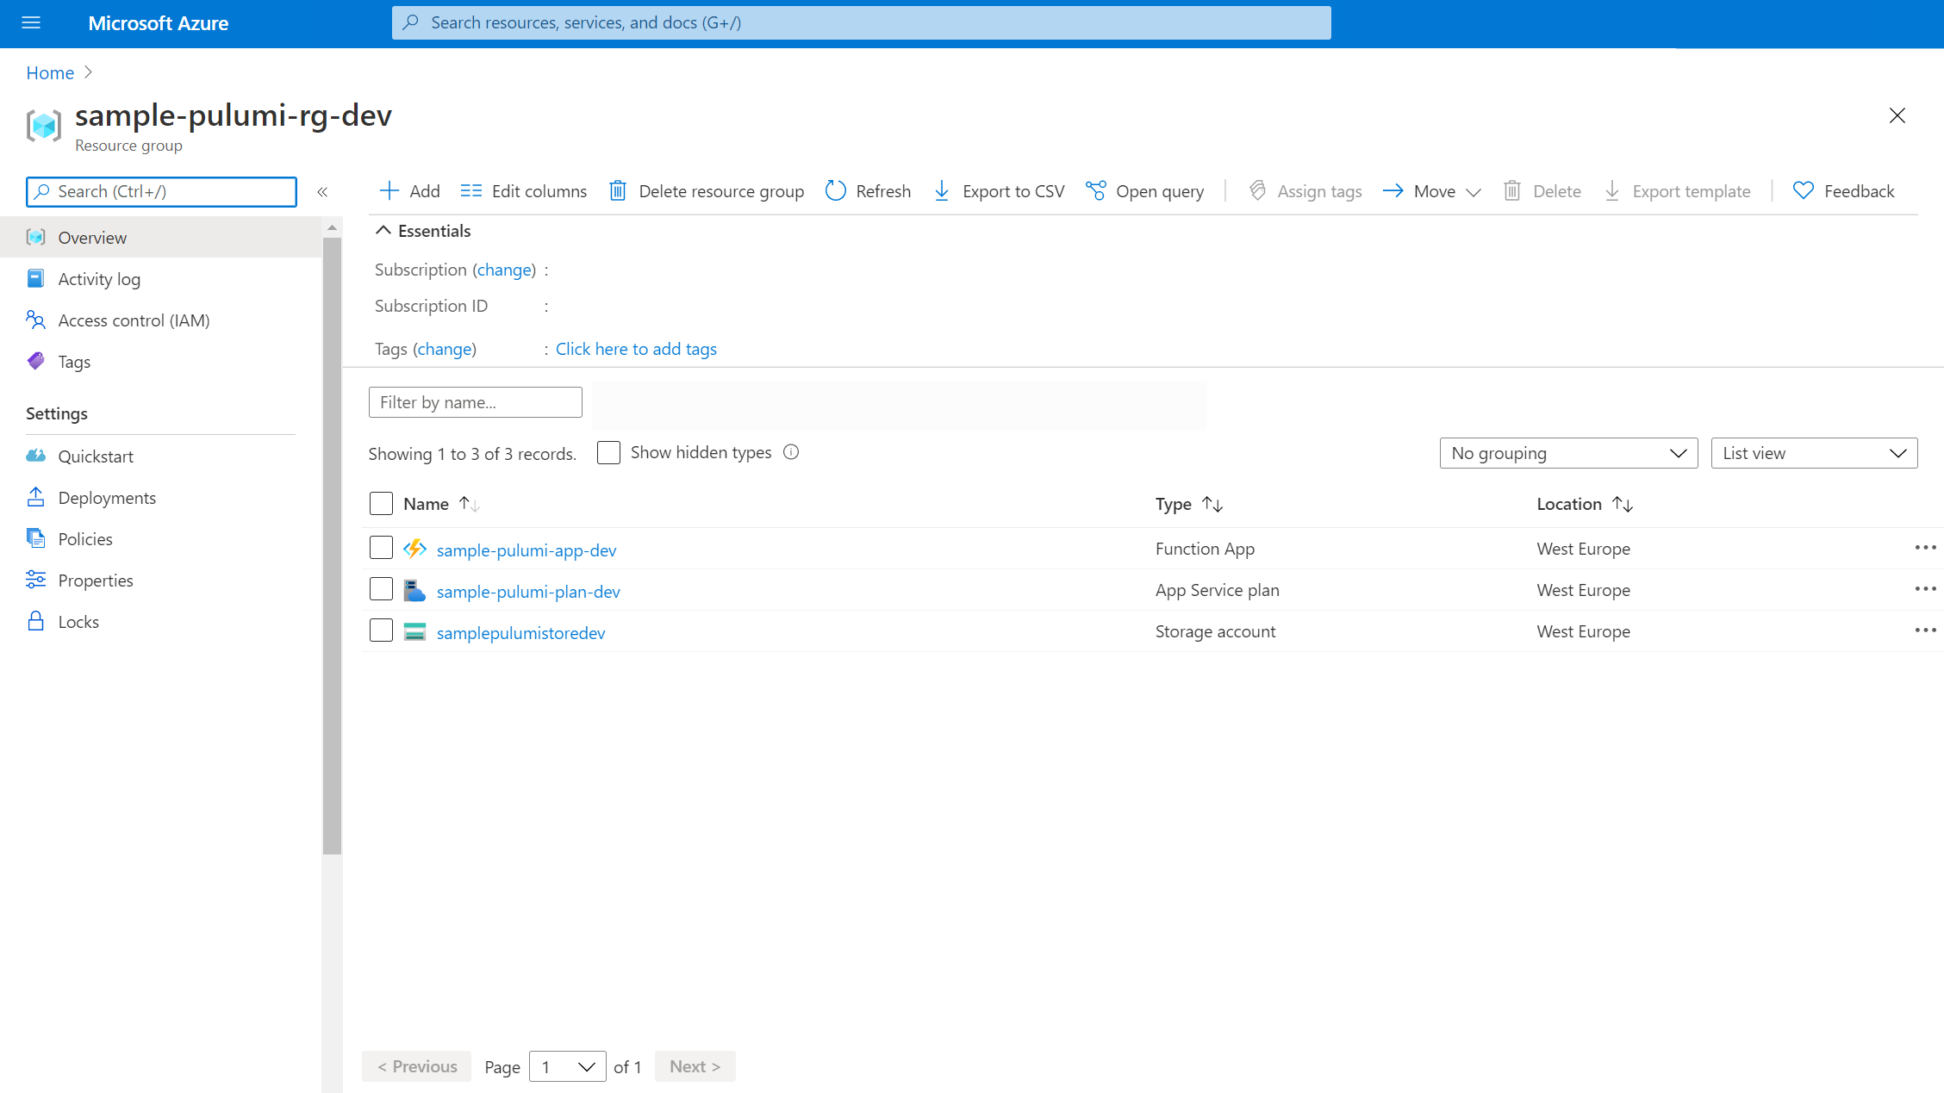
@adoranwodo

Slide 49
A few weeks later, Oge wants to update her app and as a result needs to add a key vault to her infra so that she can securely manage secrets.
@adoranwodo

Slide 50
https://github.com/AdoraNwodo/sample-pulumi-dotnet
@adoranwodo

Slide 51
Initial deployment
@adoranwodo

Slide 52
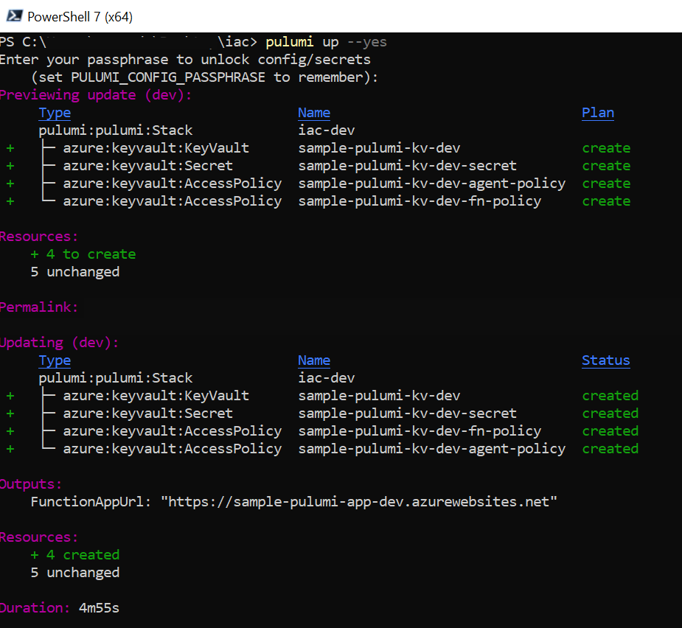
Initial deployment
@adoranwodo
Deployment after adding keyvault

Slide 53
For more Information
@adoranwodo
- Pulumi
https://www.pulumi.com/docs/intro/languages/dotnet/
- AdoraHack
https://adorahack.com/how-to-define-your-infrastructure-with-typescript-pulumi
- Building Modern Cloud Applications using Pulumi and .NET Core
https://devblogs.microsoft.com - Medium (Kehinde Ladipo)
https://medium.com/@kehinde_/infrastructure-as-code-what-is-it-all-about-c8ae2b8deddf

Slide 54
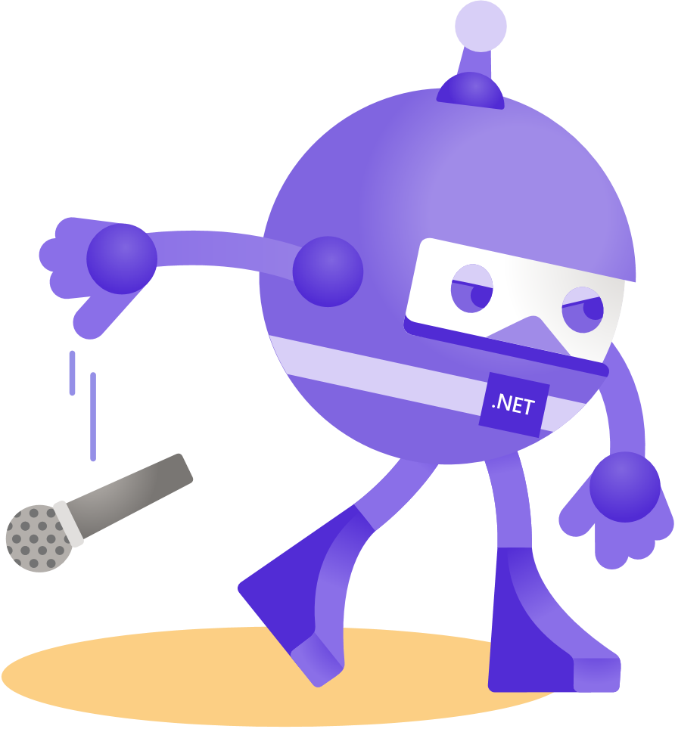
Thanks for joining!
@adoranwodo

